Slide 1

Project 1 Group 2
Nora Chian, Christopher Loch, Jacque Meyer, Eric Zhou

Slide 2


Our Questions
The goal of this project is to look for correlations related to water quality measured over a period of years across European countries. With this data, we hope to determine:
Does population density correlate with water temperatures, water acidity, and/or dissolved oxygen content?
Does gross domestic product (GDP) correlate with water temperatures, water acidity, and/or dissolved oxygen content?
Notes:
Eric

Slide 3



Dataset
Dataset combines data on:
Freshwater quality measured by the European Environmental Agency
Socioeconomic data gathered by the World Bank
Waste generation percentages gathered by the World Bank
Notes:
Eric

Slide 4
Dataset
Water quality measurements used
Temperature (degrees Celsius)
Acidity (pH)
Dissolved Oxygen content (mg O2/L)
Socioeconomic measurements used
Population Density (people per square kilometer)
Gross Domestic Product (in Trillions of USD)
Notes:
Eric

Slide 5
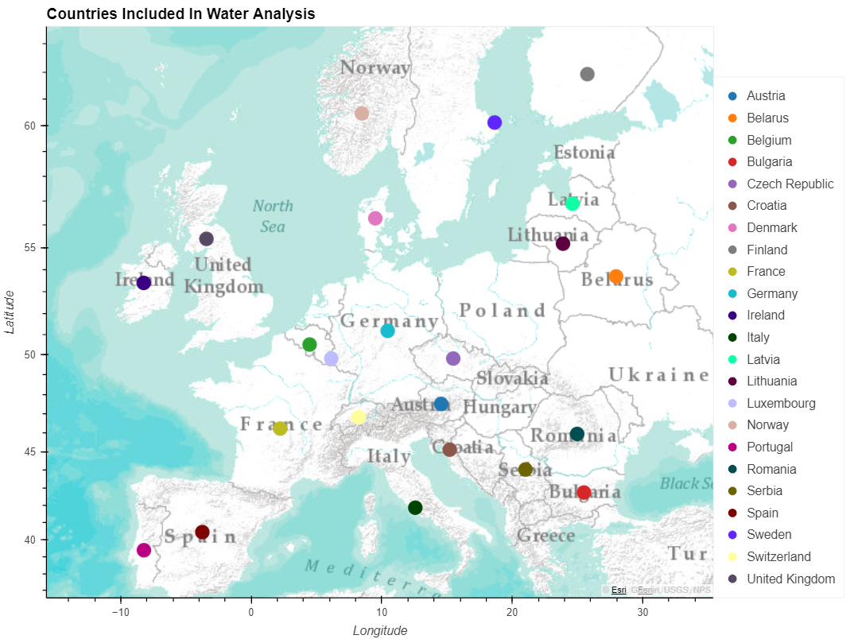
European Countries in Dataset

Slide 6
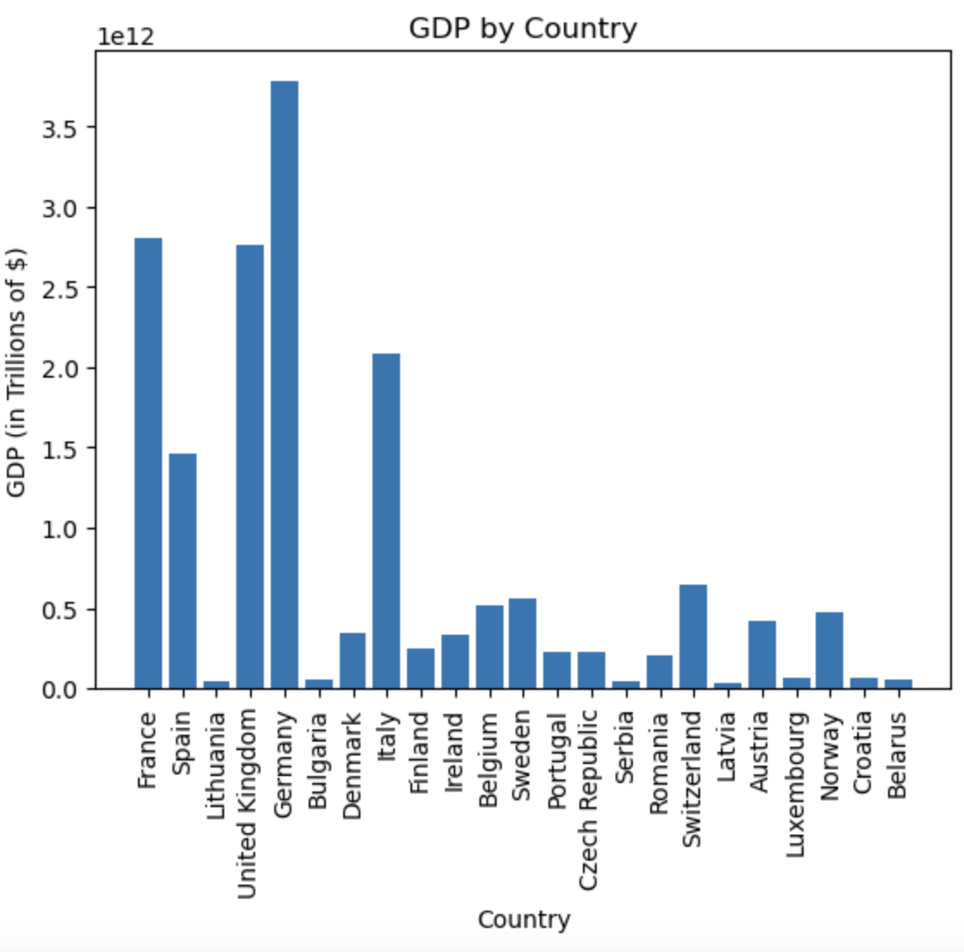
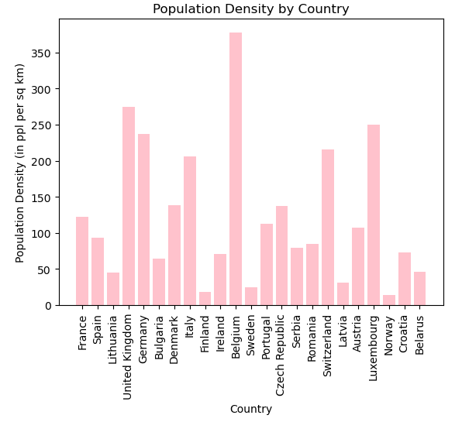
Country stats

Slide 7
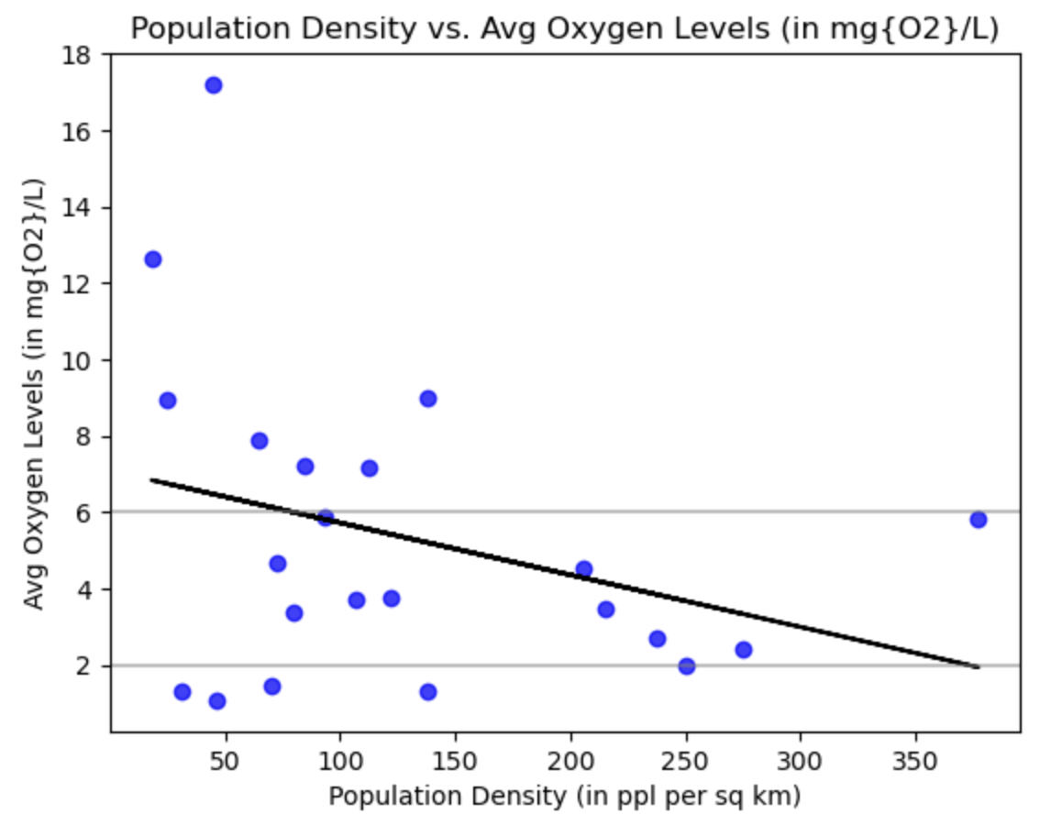
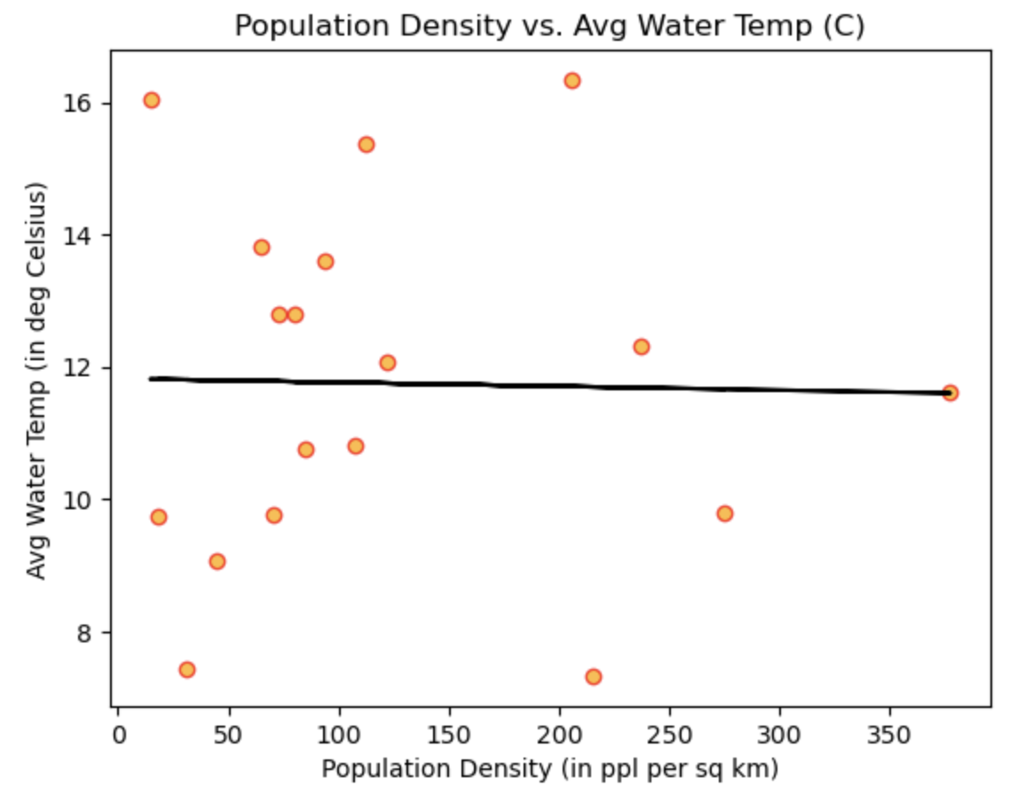
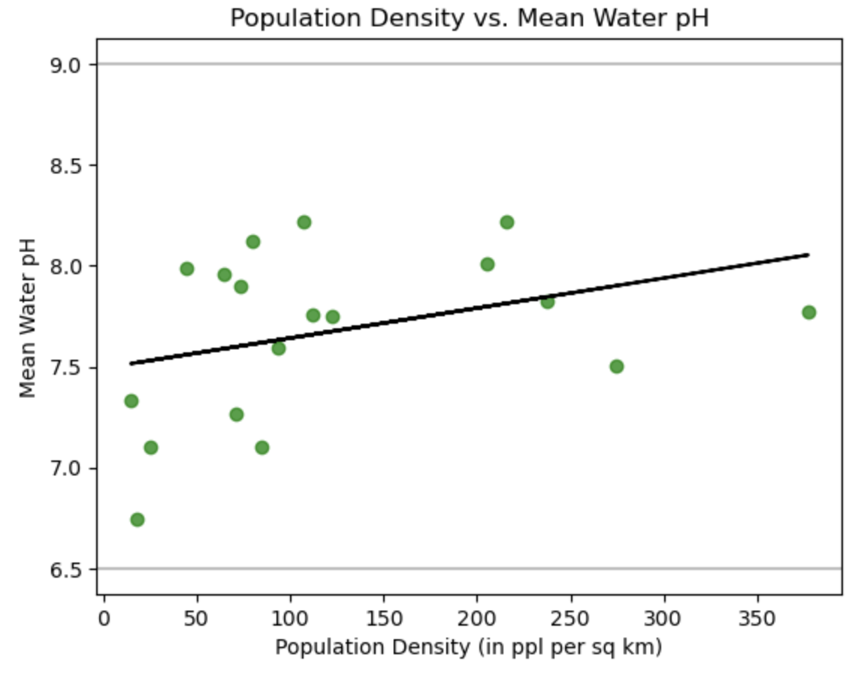
POPULATION DENSITY VS. Water Quality
Dissolved Oxygen
Water Temp
pH
The r-value is -0.32
The r-value is -0.02
The r-value is 0.35

Slide 8
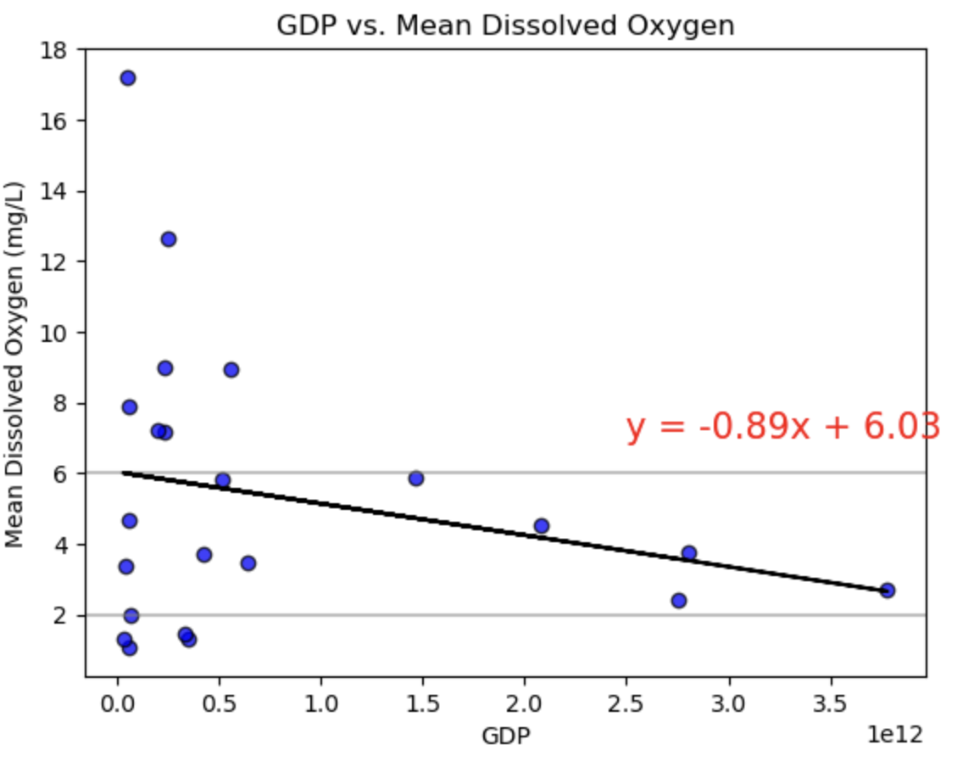
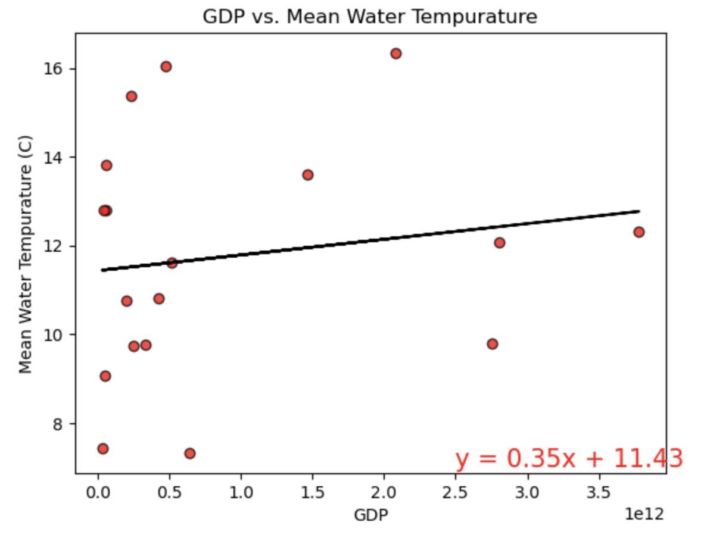
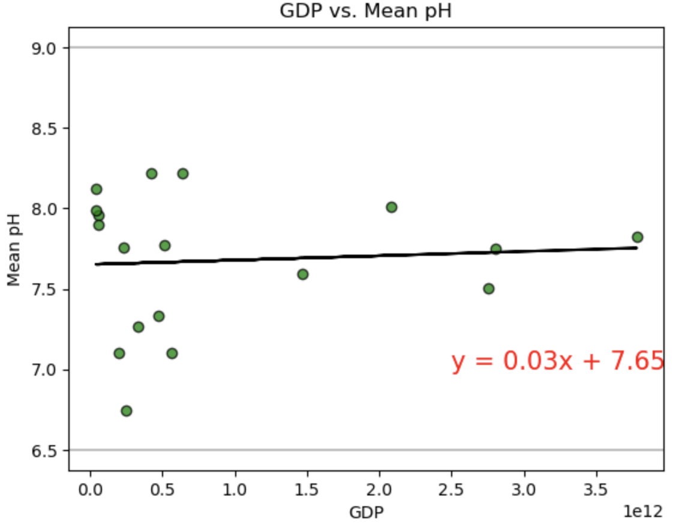
GDP VS. Water Quality
Dissolved Oxygen
Water Temp
pH
The r-value is -0.24
The r-value is 0.15
The r-value is 0.07

Slide 9
Limitations
Consistency
Years of data
Water quality measures
GDP and population density is static
Time indicator
Number of measurements

Slide 10
Summary
Water Quality vs. GDP = No Correlation found
Water Quality vs. Population Density = No Correlation found
Our conclusion is contrary to what might be expected. That is likely due to the limitations.
Many other factors could be added and change the conclusion (ie. pharmaceuticals in water may be higher in high GDP countries).
This limited analysis should not be used alone if trying to draw a general or larger conclusion about water quality.

